Slide 1
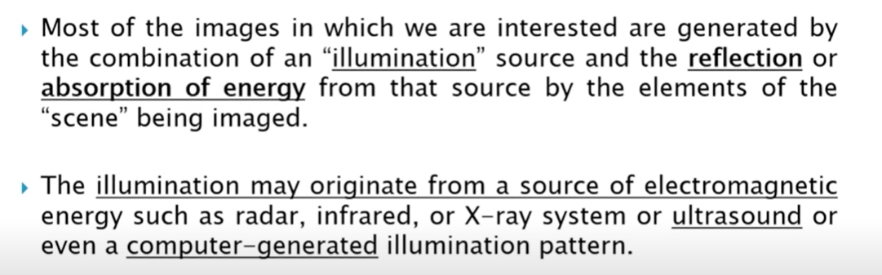
Image Sensing and Acquisition

Slide 2
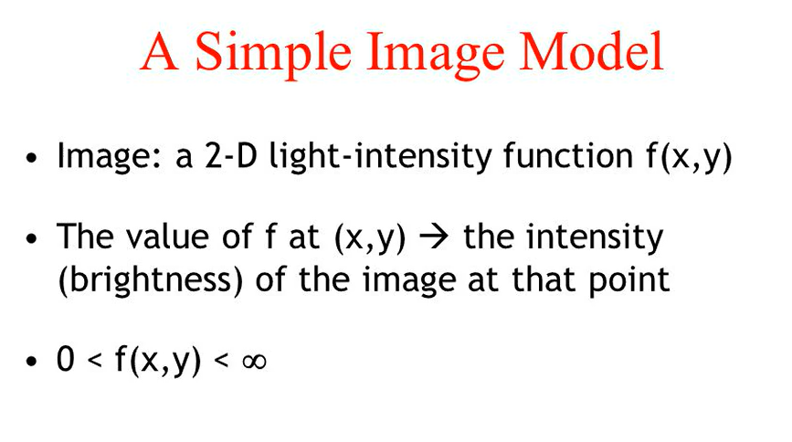

Slide 3
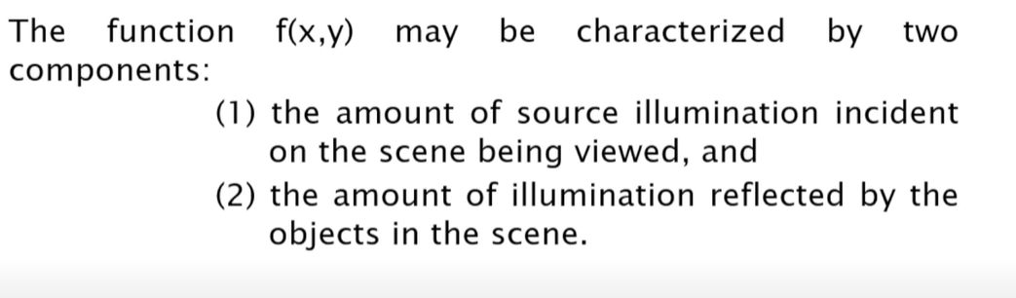
A Simple Image Formation Model
Appropriately these are called the illumination and reflectance components and are denoted by i(x,y) and r(x,y) respectively.

Slide 4
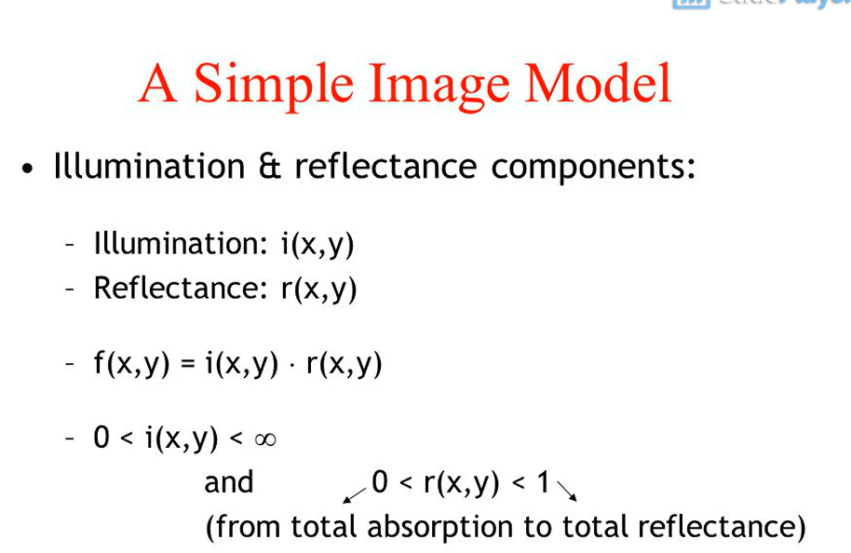
The two functions combine as a product to form f(x,y).

Slide 5
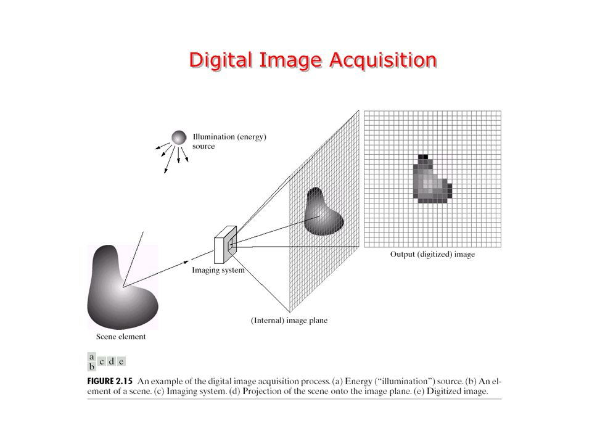

Slide 6
The previous figure shows the energy from an illumination source being reflected from a scene element.
The first function performed by the imaging system is to collect the incoming energy and focus it on to an image plane.
If the illumination is light, the front end of the imaging system is an optical lens that projects the viewed scene onto the lens focal plane.
The sensor array, which is coincident with the focal plane, produces outputs proportional to the integral of the light received at each sensor.
The analog signal is then digitized by the imaging system and the final output is a digital image.

Slide 7
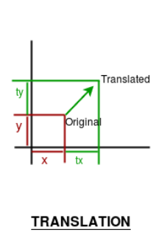
Geometric Model- Basic Transformation
Translation
Translation refers to moving an object to a different position on the screen.
Or in other words, translation transformation moves a shape by a specified distance. If you translate a rectangle by 30 pixels along the x-axis and 90 pixels along the y-axis, the new origin will be 30 pixels to the right and 90 pixels down from the original rectangle’s top-left corner.

Slide 8
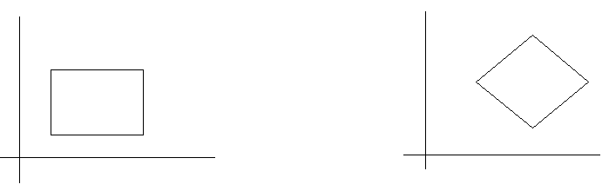
Rotation - refers to rotating a point. Or in other words, rotation transformation rotates a shape by a specified angle, expressed in degrees; 360 degrees correspond to a full rotation, and the shape appears the same. A rotation by 180 degrees is equivalent to flipping the shape vertically and horizontally. BEFORE ROTATION AFTER ROTATION

Slide 9
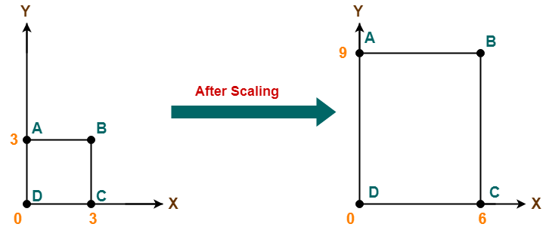
Scaling - Refers to zooming in and out an object on different scales across axes. The scaling transformation changes the dimensions of a shape but not its basic form. In the scaling process we either expand or compress the dimensions of an object. Scaling can be achieved by multiplying the original coordinates with the scaling factor to get the desired output.

Slide 10
Sampling and Quantization
The output of most of the image sensors is an analog signal, and we can not apply digital processing on it because we can not store it. We can not store it because it requires infinite memory to store a signal that can have infinite values.
So we have to convert an analog signal into a digital signal.
To create an image which is digital, we need to covert continuous data into digital form. There are two steps in which it is done.
Sampling
Quantization
To convert a continuous image f(x, y) into digital form, we have to sample the function in both co-ordinates and amplitude.

Slide 11
The basic idea behind converting an analog signal to its digital signal is to convert both of its axis(x,y) into a digital format.
Since an image is continuous not just in its co-ordinates, but also in its amplitude, so the part that deals with the digitizing of co-ordinates is known as sampling. And the part that deals with digitizing the amplitude is known as quantization.
The term sampling refers to take samples
We digitize x axis in sampling
It is done on independent variable
The key difference between uniform and nonuniform quantization is that uniform quantization has equal step sizes while, in nonuniform quantization, the step sizes are not equal. Another important difference between uniform and nonuniform quantization is that, in the uniform quantization, some amount of quantization error can happen, but nonuniform quantization reduces the quantization error.

Slide 12
Differences between Sampling and Quantization
Sampling | Quantization
Digitization of co-ordinate values. | Digitization of amplitude values.
x-axis(time) – discretized. | x-axis(time) – continuous.
y-axis(amplitude) – continuous. | y-axis(amplitude) – discretized.
Sampling is done prior to the quantization process. | Quantizatin is done after the sampling process.
It determines the spatial resolution of the digitized images. | It determines the number of grey levels in the digitized images.
A single amplitude value is selected from different values of the time interval to represent it. | Values representing the time intervals are rounded off to create a defined set of possible amplitude values.

Slide 13
THANK YOU
Prepared by -
Mrs. Jheelam Mondal
Asst. Prof, CSE department
Haldia Institute of Technology

